Slide 1

Artificial Intelligence
(AI)

Slide 2
AGENDA
Critical Thinking
Neural Network
Perceptron
MLP
Types of Neural Network

Slide 3

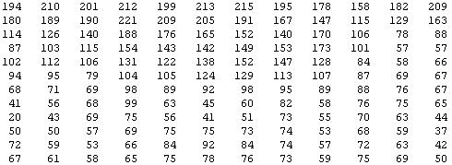
What is this?
You see this:
But the camera sees this:
Back to main

Slide 4
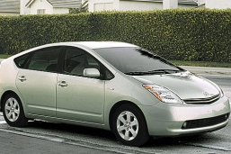








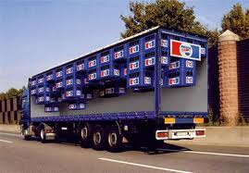



Computer Vision: Car detection
Cars
Not a car
Testing:
What is this?

Slide 5



Learning Algorithm
pixel 1
Learning Algorithm
pixel 2
Raw image
pixel 2
Cars
pixel 1
“Non”-Cars

Slide 6
Learning Algorithm
pixel 1
Learning Algorithm
pixel 2
Raw image
pixel 2
Cars
“Non”-Cars
pixel 1

Slide 7
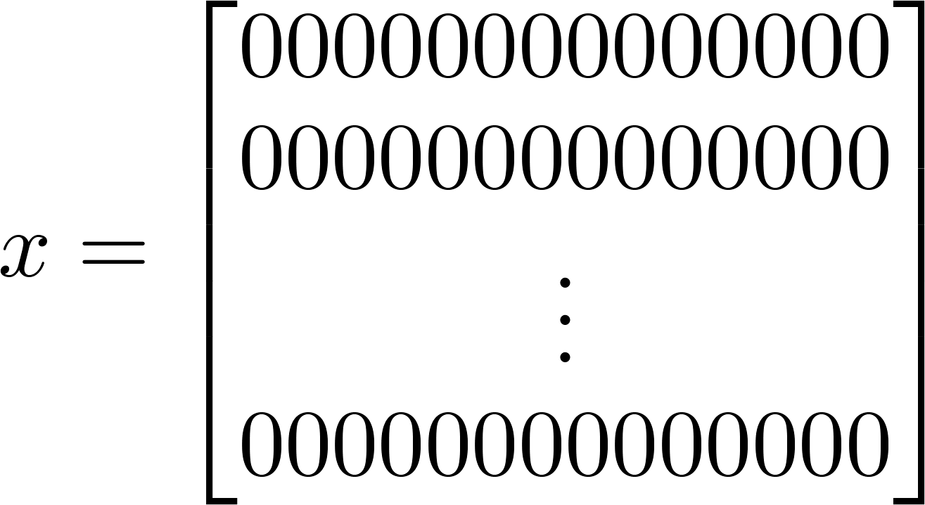

pixel 1
Learning Algorithm
pixel 2
Raw image
50 x 50 pixel images→ 2500 pixels
n= 2500 (7500 if RGB)
pixel 2
pixel 1 intensity
pixel 2 intensity
pixel 2500 intensity
Cars
pixel 1
Quadratic features ( ): ≈3 million features
“Non”-Cars
Back to main

Slide 8
Neural Networks: Representation
Neurons and the brain
Back to main

Slide 9
Neural Network Origin
Origins: Algorithms that try to mimic the brain.
Was very widely used in 80s and early 90s; popularity diminished in late 90s.
Recent resurgence: State-of-the-art technique for many applications

Slide 10
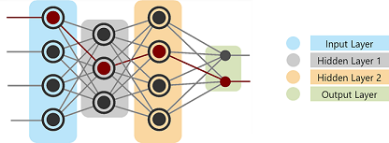
Definition Of A Neural Network
Modeled in accordance with the human brain, a Neural Network was built to mimic the functionality of a human brain. The human brain is a neural network made up of multiple neurons, similarly, an Artificial Neural Network (ANN) is made up of multiple perceptron's (explained later).

Slide 11
Layers in Neural Network
A neural network consists of three important layers:
Input Layer
Hidden Layer
Output Layer

Slide 12
hidden layer
A hidden layer in an artificial neural network is a layer in between input layers and output layers, where artificial neurons take in a set of weighted inputs and produce an output through an activation function.

Slide 13
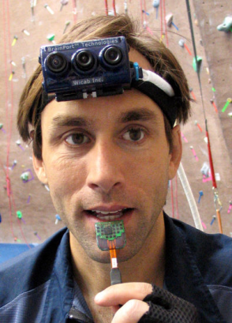


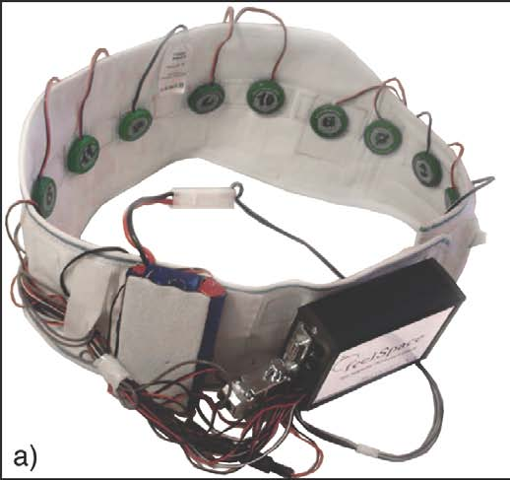

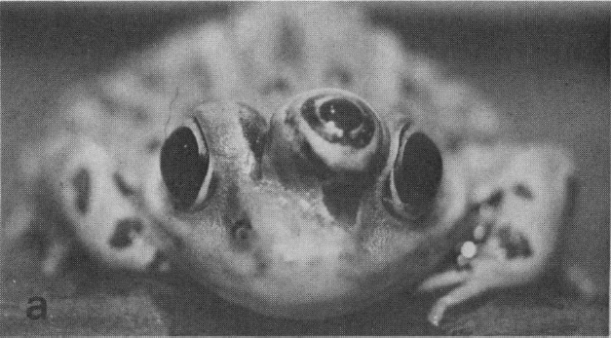
Sensor representations in the brain
Human echolocation (sonar)
Seeing with your tongue
Haptic belt: Direction sense
Implanting a 3rd eye

Slide 14
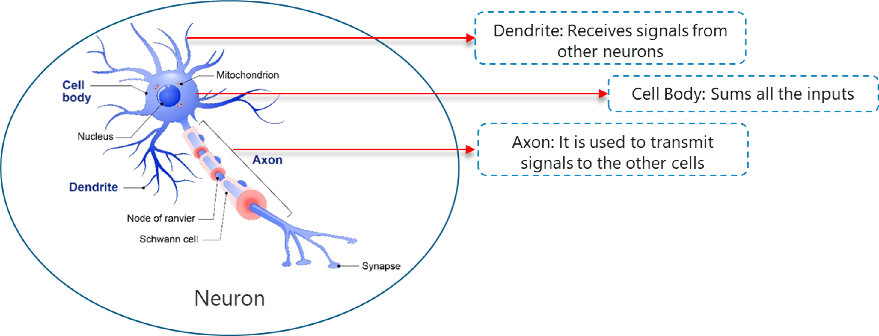
Motivation behind neural network
The building block of a neural network is the neuron. An artificial neuron works much the same way the biological one days.

Slide 15
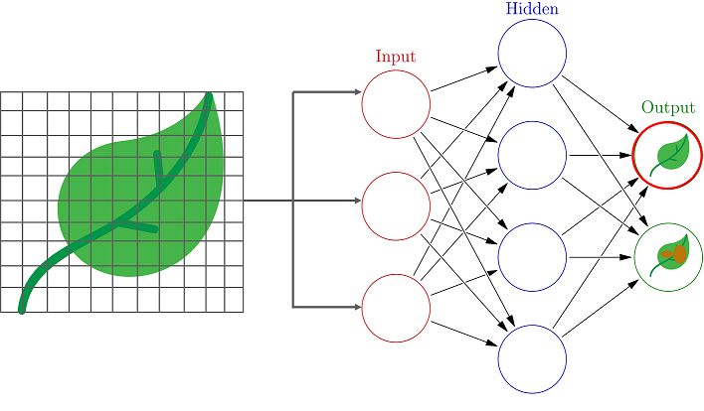
Neural Networks Explained With An Example
Class A: Containing images of non-diseased leaves
Class B: Containing images of diseased leaves

Slide 16
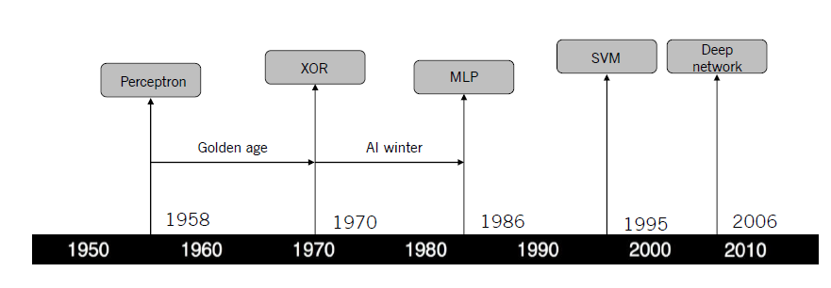
Development History of Neural Networks
Back to main

Slide 17
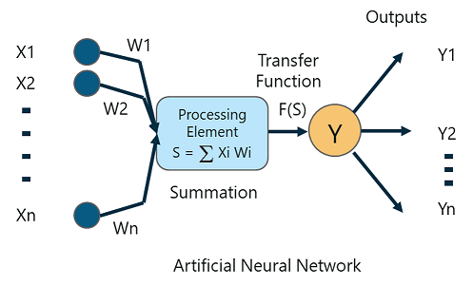
What Is A Perceptron?
A Perceptron is a single layer neural network that is used to classify linear data. It has 4 important components:
  Inputs
  Weights and Bias
  Summation Function
  Activation or transformation Function
Back to main

Slide 18
Limitations of Single-Layer Perceptron:
Single-Layer Perceptron cannot classify non-linearly separable data points.
Complex problems, that involve a lot of parameters cannot be solved by Single-Layer Perceptron.

Slide 19
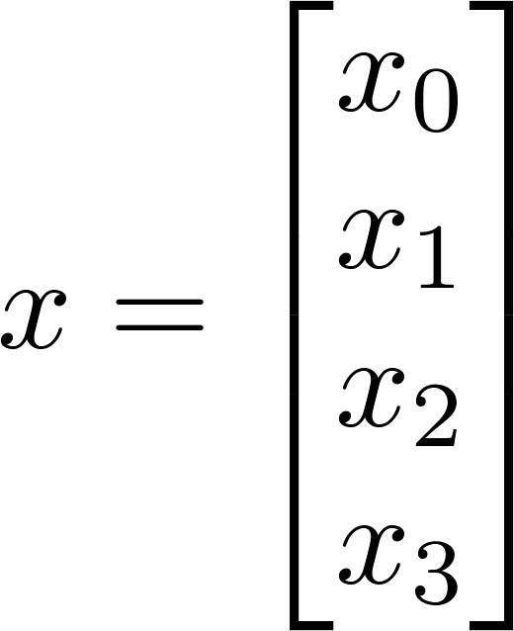
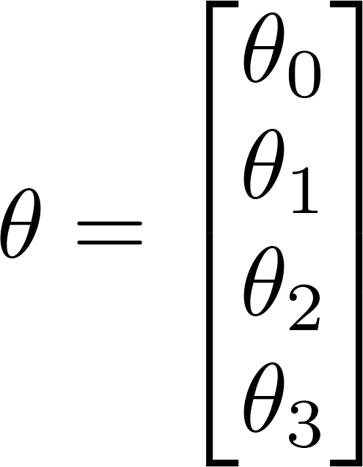




Neuron model: Logistic unit
Sigmoid (logistic) activation function.

Slide 20


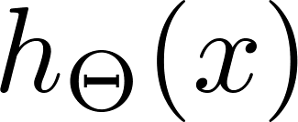




Neural Network
Layer 1
Layer 2
Layer 3

Slide 21
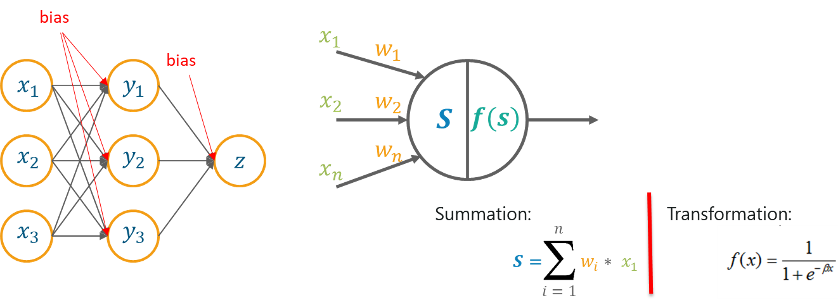
What Is A Multilayer Perceptron?
A Multilayer perceptron is a classifier that contains one or more hidden layers and it is based on the Feedforward artificial neural network. In the Feedforward networks, each neural network layer is fully connected to the following layer.
Back to main

Slide 22
Types of Neural Network
ANN (Artificial neural network)
CNN (Convolutional neural network)
RNN (Recurrent neural network)
Back to main

Slide 23
Neural Network intuition
Layer 1
Layer 2
Layer 3
Layer 4

Slide 24
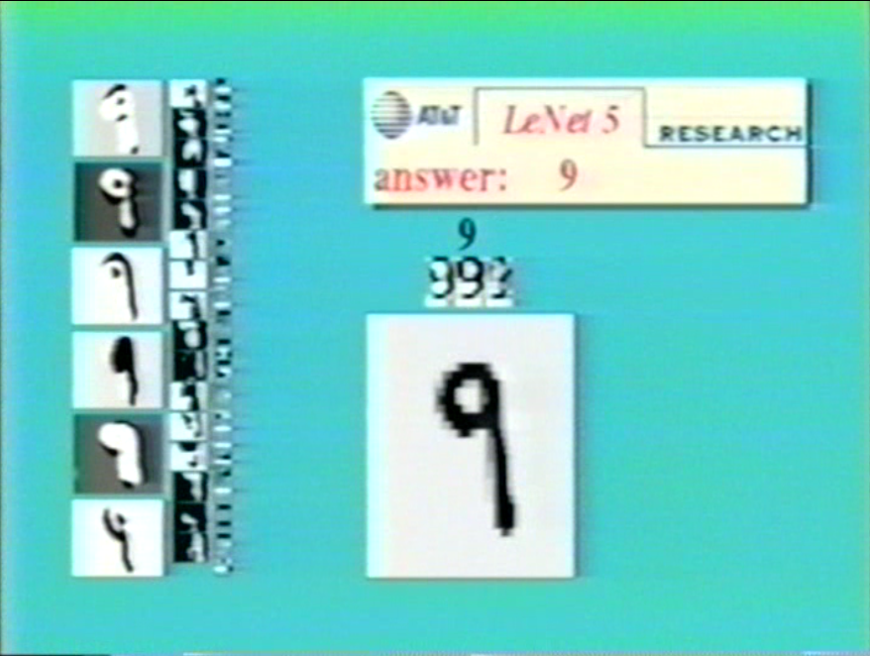
Handwritten digit classification

Slide 25








Neural Network (Classification)
total no. of layers in network
no. of units (not counting bias unit) in layer
Layer 1
Layer 2
Layer 3
Layer 4
Multi-class classification (K classes)
K output units
Binary classification
1 output unit
E.g. , , ,
pedestrian car motorcycle truck

Slide 26
Activation Function
An activation function in a neural network defines how the weighted sum of the input is transformed into an output from a node or nodes in a layer of the network

Slide 27

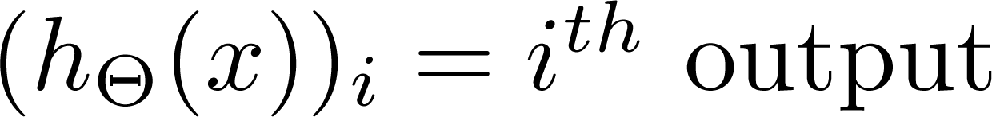
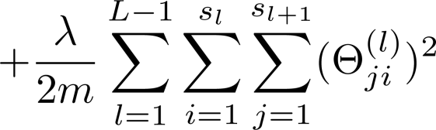
Cost function
Logistic regression:
Neural network:
Back to main

